Slide 1
Capturing Requirements Through
Use-Cases
Examples

Slide 2
Subsystems
Admission Subsystem
Registration and Coursework Subsystem
Fees and Scholarships Subsystem
Exam Subsystem
Hall Subsystem
Library Subsystem
HR Subsystem
Salary, Leave and Holyday Subsystem
Departmental Subsystem
Etc.

Slide 3
Admission Subsystem Actors
Applicant
Examinee
Accepted Student
Question Setter
Question Moderator
Invigilator
Examiner
Exam Controller
Exam Control Office Employee
Registrar
Accounts section employee
Bank
Health Complex employee
Health Complex Doctor
Time
Others

Slide 4
Use-Cases for Admission Subsystem
Use-Case Name | Actors
Distribute Form | Applicant, Accounts section Employee
Submit Form | Applicant, Accounts section Employee
Sort | Exam Control office employee
Assign Question Setter | Exam Controller, Teacher
Assign Question Moderator | Exam Controller, Teacher
Assign Invigilator | Exam Controller, Teacher, Staff
Assign Examiner | Exam Controller, Teacher
Sit for exam | Examinee
Guard Exam | Invigilator

Slide 5
Use-Cases for Admission Subsystem
Use-Case Name | Actors
Set Question | Question Setter
Moderate Question | Question Moderator
Examine | Examiner
Prepare Result | Exam Control Office Employee
View Result | All
Give Choice | Accepted Students
Sort out choice | Exam Control Office Employee
Perform Medical Checkup | Accepted student, Med Officer, Med Employee
Select from Waiting List | Time, Exam Control Office Employee

Slide 6
Use-Cases for Registration and Coursework Subsystem
Use-Case Name | Actors
Pay Fee | Student, Registrar Office, Bank Teller, Hall Clerk
Register | Student, Adviser
Prepare Student List | Registrar Office
View Student List | Teacher, Lab Attendant, Exam Control Office

Slide 7
Use-Cases for Registration and Coursework Subsystem
Use-Case Name | Actors
Issue Instrument | Student, Lab Attendant
Return Instrument | Student, Lab Attendant
Post Notice | Teacher, Head
View Notice | Teacher, Student

Slide 8
Use-Cases for Registration and Coursework Subsystem
Use-Case Name | Actors
Assign Teacher | BUGS, Teacher
Prepare Routine | Routine Committee, BUGS
Send Routine | Routine Committee, Head
View Routine | Student, Teacher, Lab Attendant, Others
Attend Class | Student, Teacher
Take Class Test | Teacher
Sit for Class Test | Student
Update Class Test Marks | Teacher
View Class Test Marks | Student, Head

Slide 9
Use-Cases for Exam Subsystem
Use-Case Name | Actors
Assign Examiner | BUGS, Teacher
Assign Question Scrutinizer | BUGS
Assign Scrutinizer | BUGS
Set Question | Teacher
Scrutinize Question | Teacher, Head
Print Question | Exam Control Office
Set Schedule | Exam Control Office
View Schedule | Student, Teacher, Others
Propose change in schedule | Student, Teacher

Slide 10
Use-Cases for Exam Subsystem
Use-Case Name | Actors
Update Schedule | Exam Control Office
Make Sit Plan | Exam Control Office
Prepare exam guard schedule | Exam Control Office, Teacher
Sit for Exam | Student
Guard Exam | Teacher, Exam Control Office
Mark Exam Papers | Teacher
Scrutinize | Teacher
Ask for Re-scrutiny | Student, Teacher, Head

Slide 11
Use-Cases for Exam Subsystem
Use-Case Name | Actors
Prepare Grade-sheet | Teacher, Head, Exam Control Office
Update Grades | Exam Control Office
Print Result | Exam Control Office
Get Result | Student, Exam Control Office
Search Result | Teacher, Student
Send Result | Exam Control Office, Registrar Office, Parents

Slide 12
Use-Case Diagram for Registration Subsystem
System
Prepare
Student
List
Adviser
Register
Registrar Office
Teacher
And
Lab Attendant
View
Student
List
Student
Hall
Pay Fee
Exam Control
Office
Bank

Slide 13
Use-Case Diagram for Registration Subsystem (refined)
System
Access
Student’s
Result
<< uses >>
Register
Teacher
And
Lab Attendant
Adviser
Registrar Office
Prepare
Student
List
View
Student
List
Verify
Fee
Student
Hall
<< extends >>
<< extends >>
Calculate
Fee
Pay Fee
Exam Control
Office
Bank

Slide 14
Sample Use Case Narrative
Name: Prepare Grade-sheet
Priority: High
Primary Actor: Teacher, Scrutinizer
Secondary Actor: Head, Exam Control Office
Precondition: Exam papers have been checked and scrutinized
Trigger: Grade-sheet form arrives from Exam Control Office

Slide 15
Sample Use Case Narrative
Typical Course of events
User Action | System Response
Step 1: Teacher calculates the attendance marks for each student of that course
Step 2: Teacher selects best three class test marks
Step 3: Teacher calculates the total class test marks
Step 4: Teacher enters the marks of attendance, class tests, section A and section B of a student | Step 5: System finds the total marks, the percentage of marks, the grade and grade point
Repeat step 4 and 5 until the actor does either of the following

Slide 16
Sample Use Case Narrative
Typical Course of events
User Action | System Response
Step 6.1: Log out | Step 7.1: Save the information and log out the user
Step 6.2: Forward to scrutinizer | Step 7.2: Save the information and forward to scrutinizer
Step 6.3 Save | Step 7.3: Save the information and go back to step 4

Slide 17
Sample Use Case Narrative
Alternate Course of events:
  Alt 7.2: If the grades of all the students are not entered yet, prompt the teacher to complete them, save the information and go back to step 4
Conclusion: The scrutinizer is notified.
Post Condition: The grades of all the students registered for that course have been calculated and are ready for scrutiny

Slide 18
Sample Use Case Narrative
Business Rules:
  Attendance Marks rule
    90%+ gets 30, … , below 60% gets 0
  Weights
    Attendance – 30
    Class Test – 60
    Section A – 105
    Section B – 105
  A student retaking a course can not get a grade above B

Slide 19
Finding Data (Take a narration)
Typical Course of events
User Action | System Response
Step 1: Teacher calculates the attendance marks for each student of that course
Step 2: Teacher selects best three class test marks
Step 3: Teacher calculates the total class test marks
Step 4: Teacher enters the marks of attendance, class tests, section A and section B of a student | Step 5: System finds the total marks, the percentage of marks, the grade and grade point
Repeat step 4 and 5 until the actor does either of the following

Slide 20
Finding Data (Identify Nouns)
Typical Course of events
User Action | System Response
Step 1: Teacher calculates the attendance marks for each student of that course
Step 2: Teacher selects best three class test marks
Step 3: Teacher calculates the total class test marks
Step 4: Teacher enters the marks of attendance, class tests, section A and section B of a student | Step 5: System finds the total marks, the percentage of marks, the grade and grade point
Repeat step 4 and 5 until the actor does either of the following

Slide 21
Finding Data (Refine the choice: Entity and Attributes)
Typical Course of events
User Action | System Response
Step 1: Teacher calculates the attendance marks for each student of that course
Step 2: Teacher selects best three class test marks
Step 3: Teacher calculates the total class test marks
Step 4: Teacher enters the marks of attendance, class tests, section A and section B of a student | Step 5: System finds the total marks, the percentage of marks, the grade and grade point
Repeat step 4 and 5 until the actor does either of the following

Slide 22
Finding Data (Refine More: Identify redundancy)
Typical Course of events
User Action | System Response
Step 1: Teacher calculates the attendance marks for each student of that course
Step 2: Teacher selects best three class test marks
Step 3: Teacher calculates the total class test marks
Step 4: Teacher enters the marks of attendance, class tests, section A and section B of a student | Step 5: System finds the total marks, the percentage of marks, the grade and grade point
Repeat step 4 and 5 until the actor does either of the following

Slide 23
Other sources of data
The mapping rule must be in the database
Business Rules:
  Attendance Marks rule
    90%+ gets 30, … , below 60% gets 0
  Weights
    Attendance – 30
    Class Test – 60
    Section A – 105
    Section B – 105
  A student retaking a course can not get a grade above B
And from other fields as well
Status Attribute Needed

Slide 24
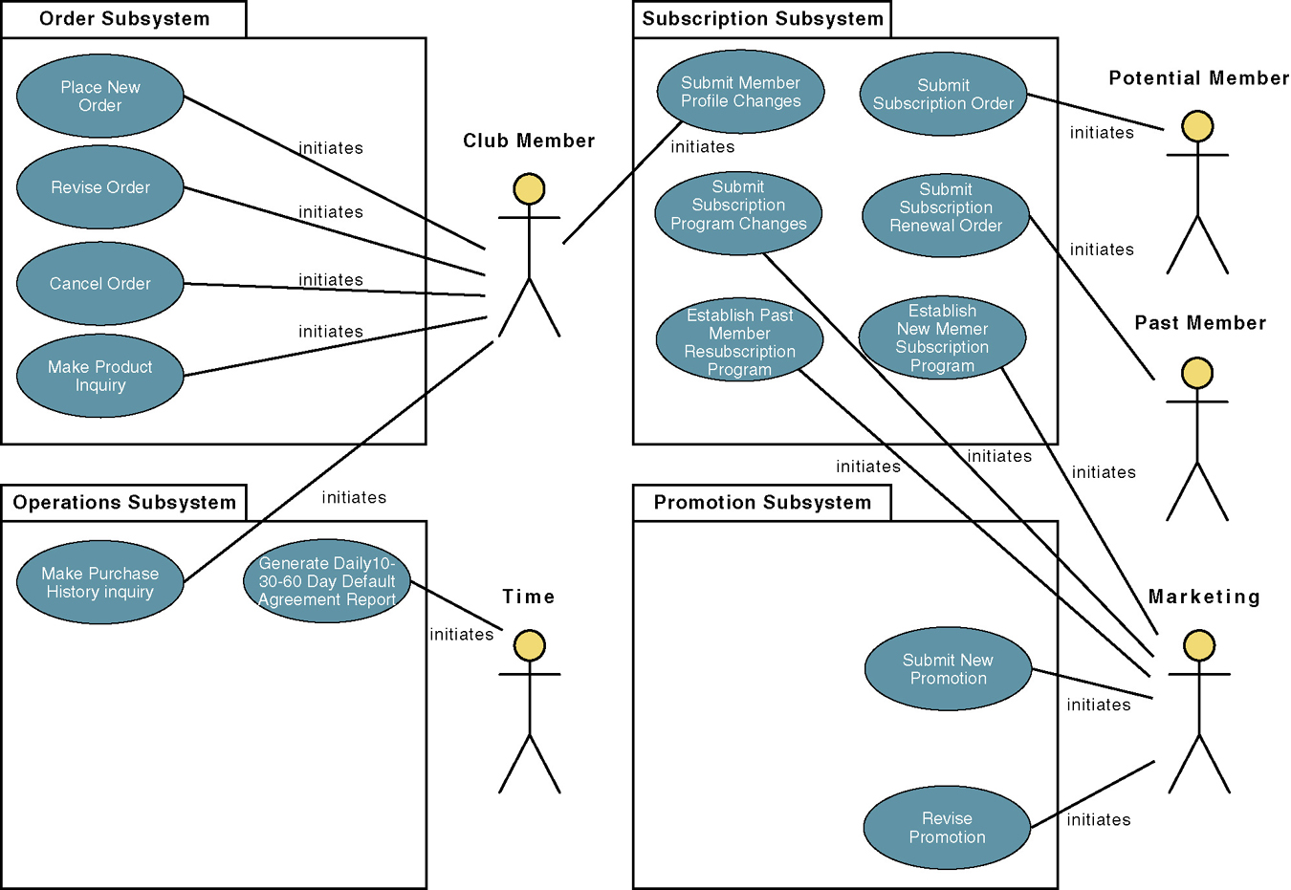
Another example: Use-Case Model Diagram

